Slide 1


Slide 2


International mentorship group with a focus on helping more women become active participants and leaders in the Python open-source community
Our mission is to promote, educate and advance a diverse Python community through outreach, education, conferences, events and social gatherings
Started in PyCon 2011 in Los Angeles
pip install pyladies
slackin.pyladies.com (Slack Workspace - Channel Name: city-chennai)

Slide 3
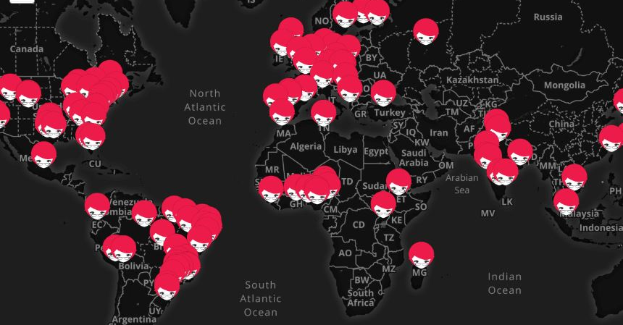
100+ chapters worldwide, 7+ chapters in India

Slide 4
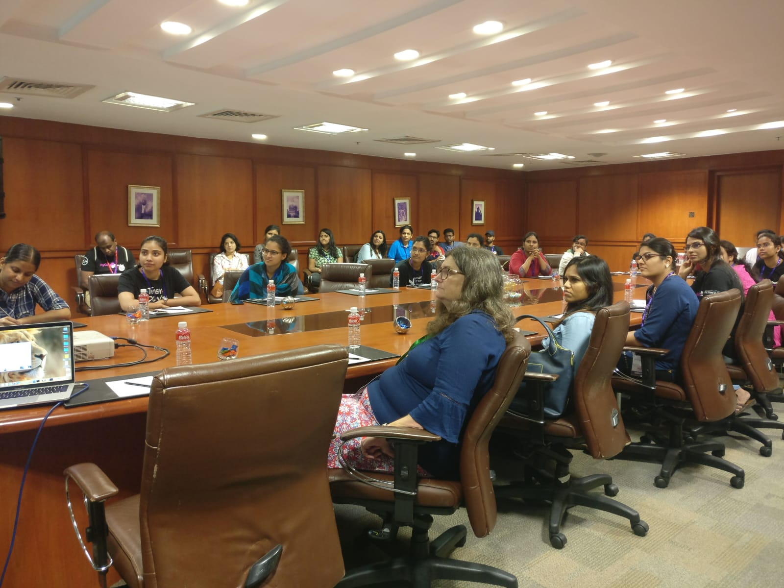

Where it all started?
INSPIRATION
Carol Willing, Core Developer of Jupyter Notebook
Anwesha Das, Organiser of PyLadies Pune
And inspiring stories of other women attendees!

Slide 6
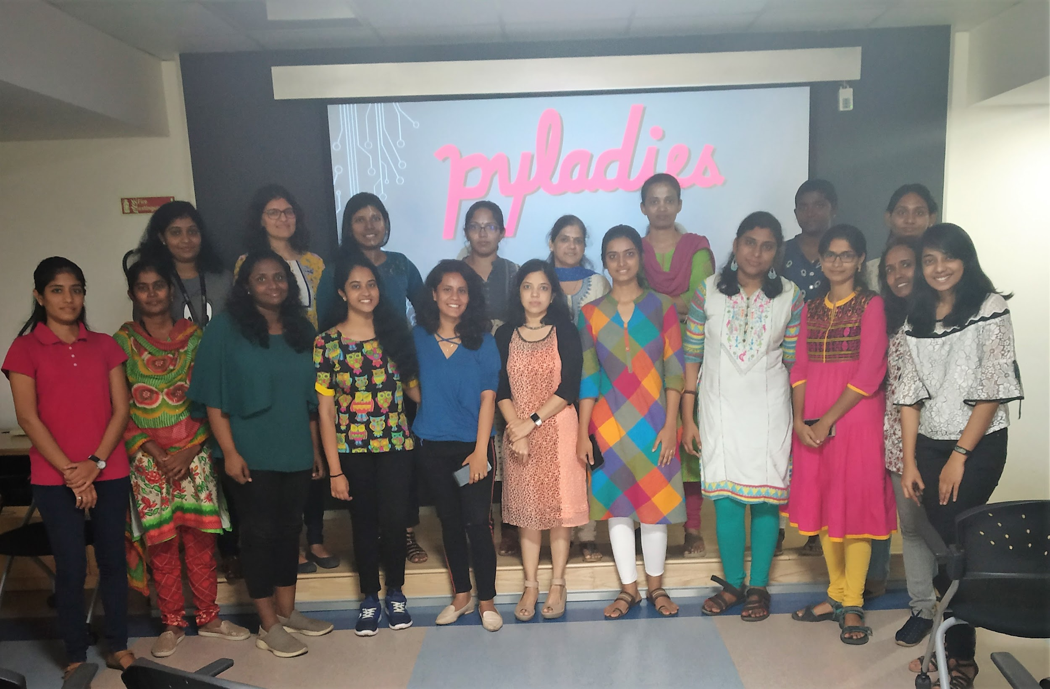
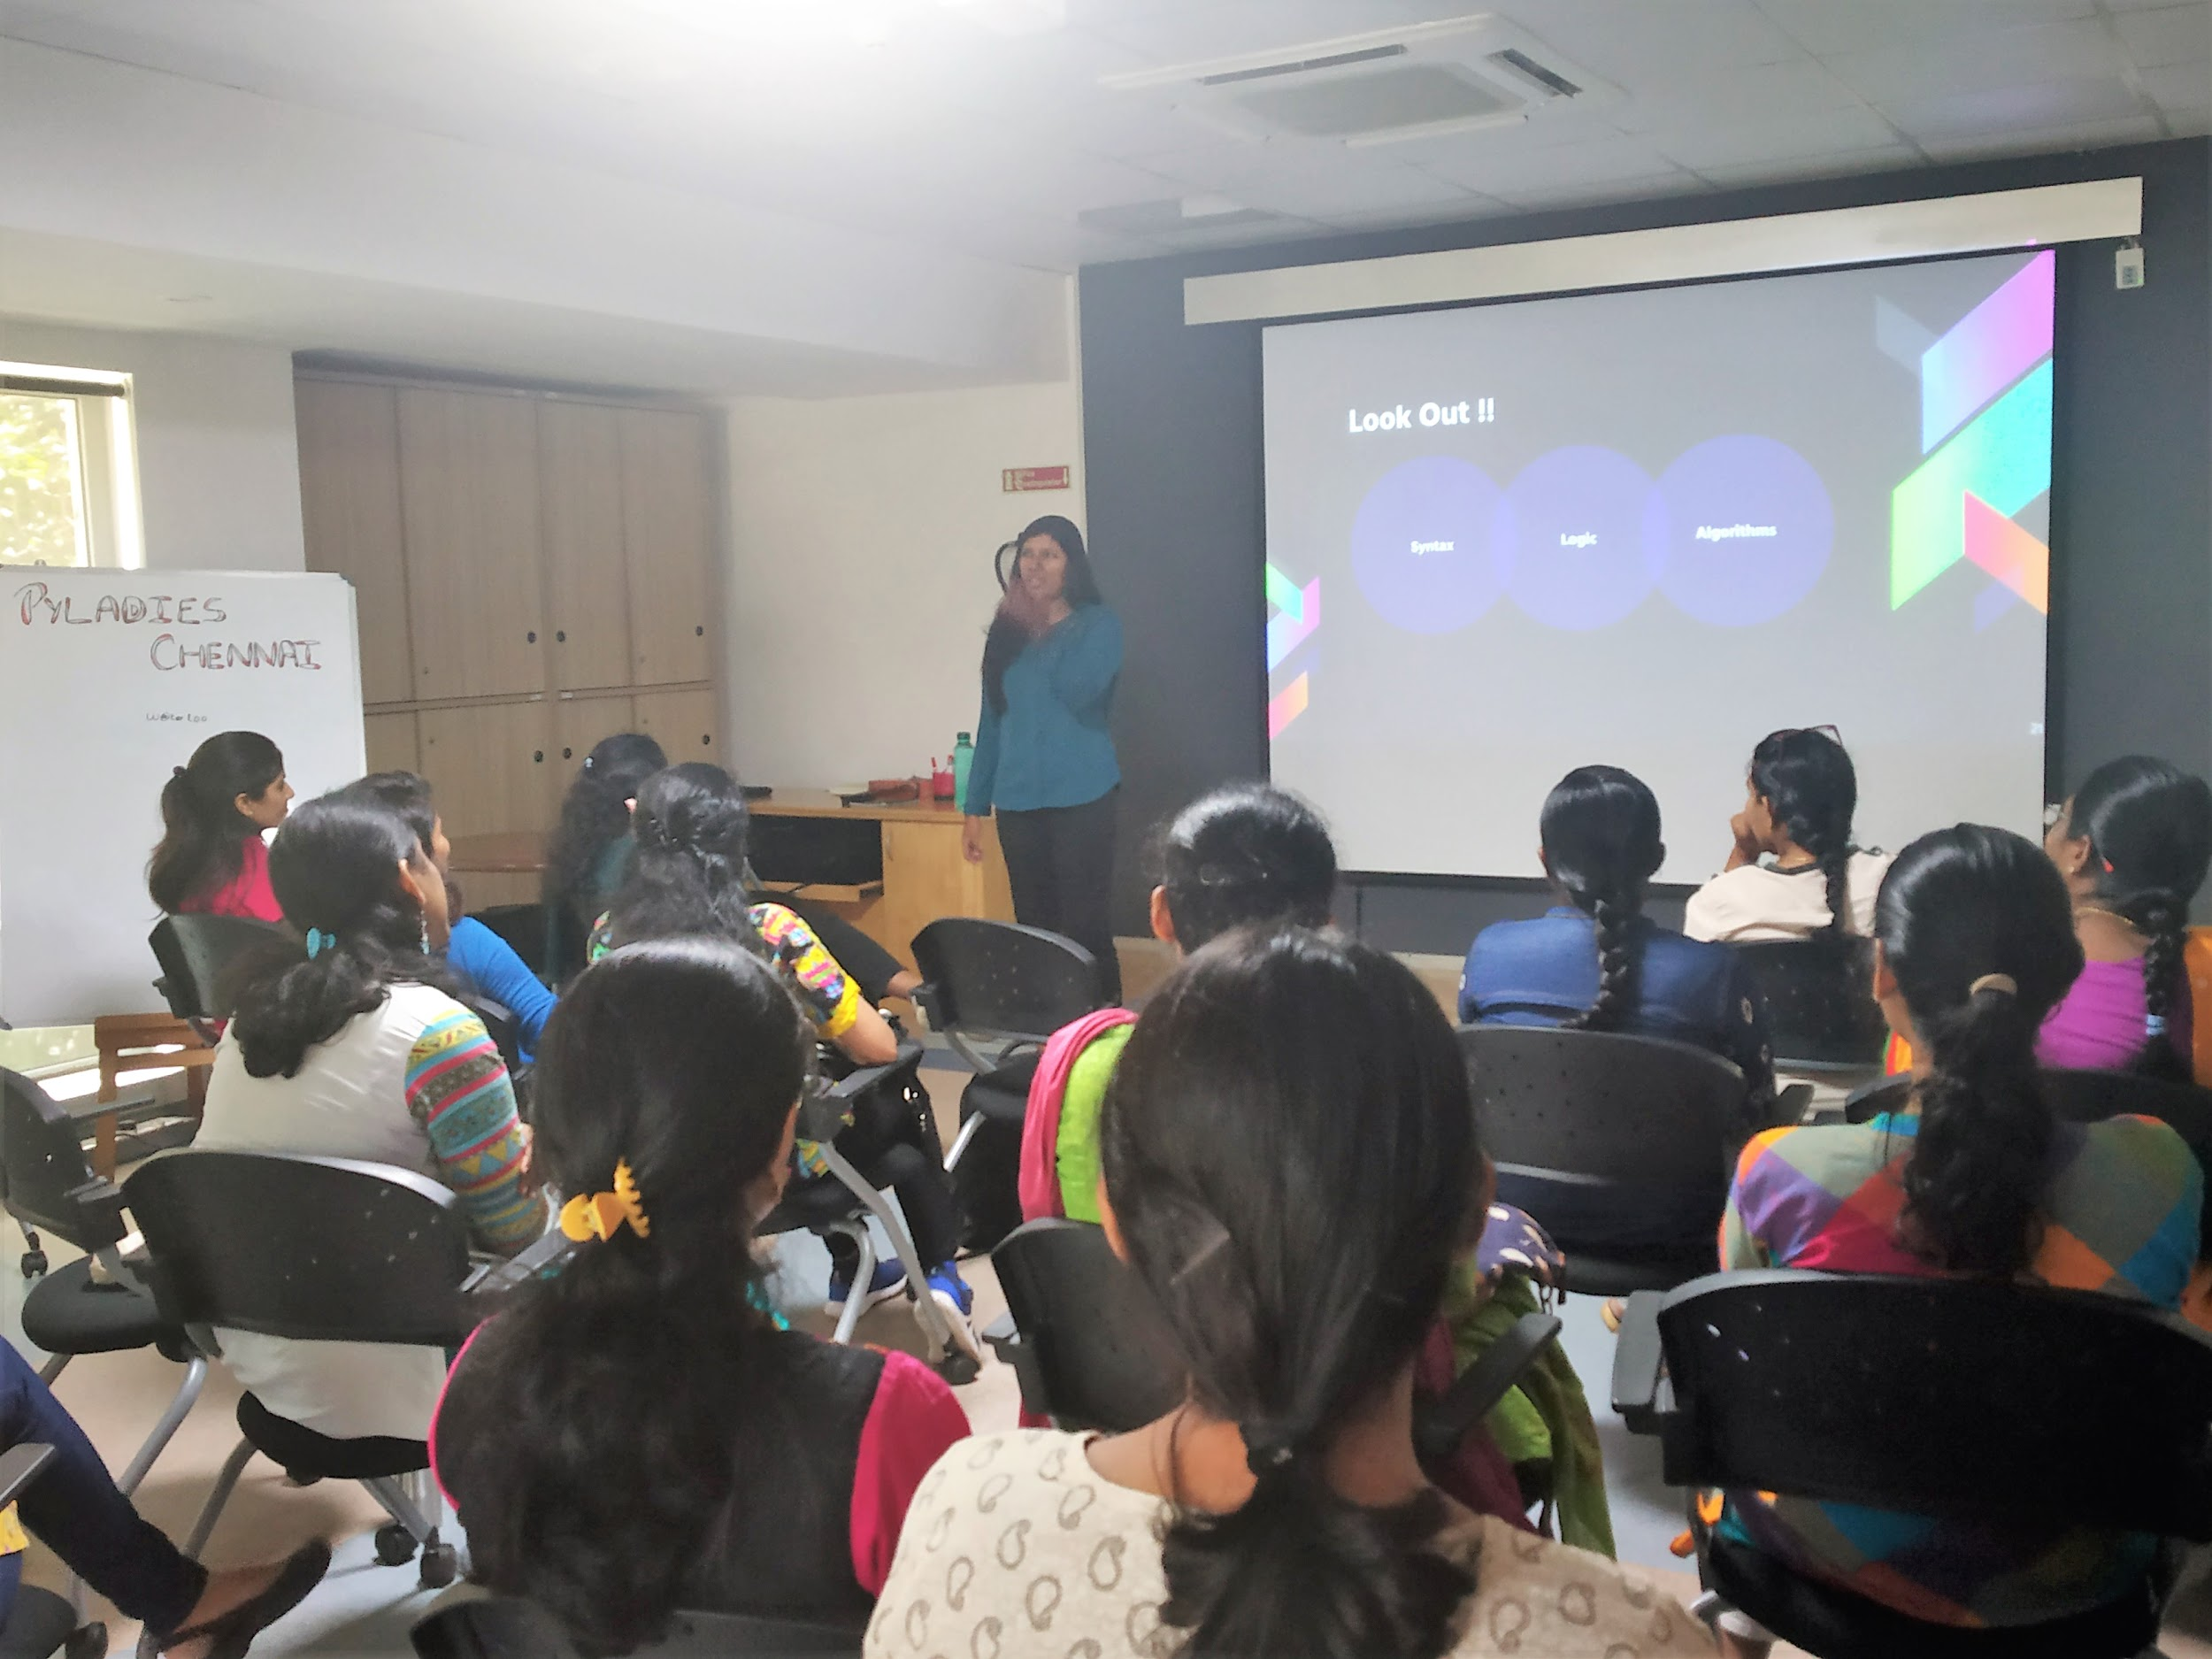
First Meetup - March 2019
Start of a new beginning ~ Chennai women Python Enthusiasts under one roof

Slide 7
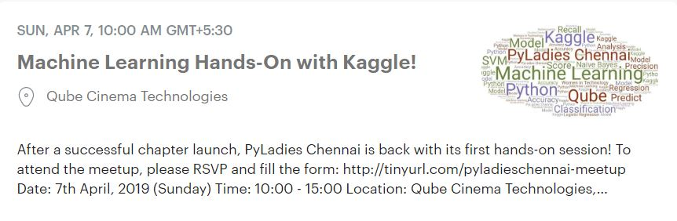
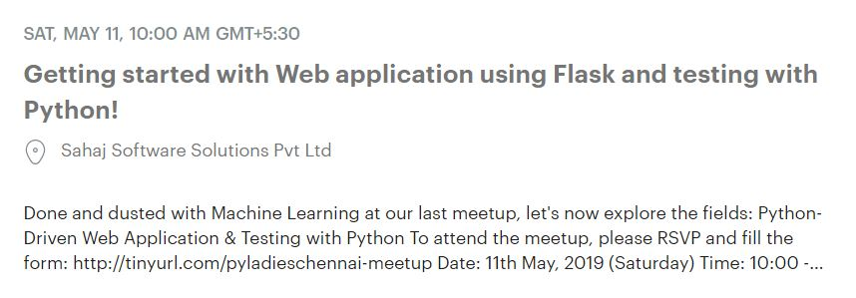
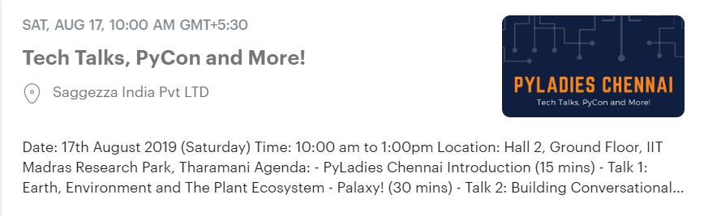

Slide 8
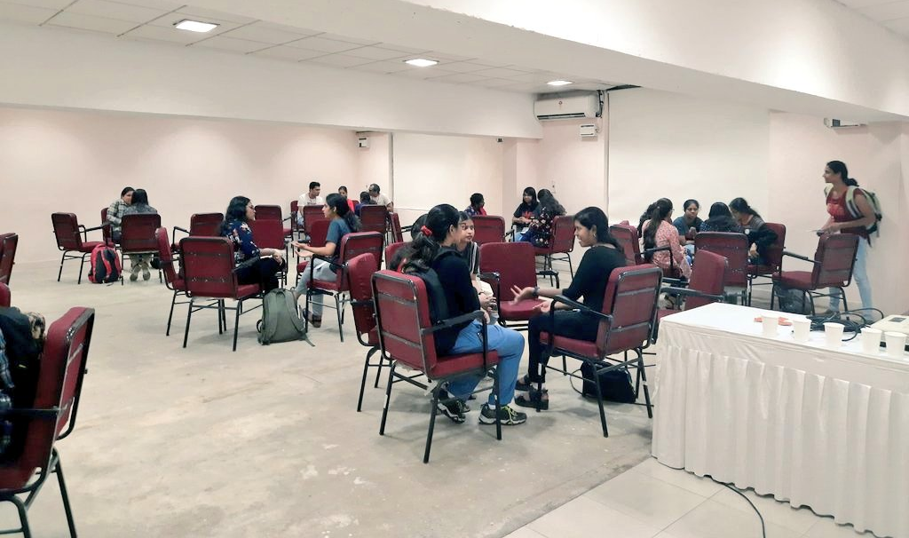
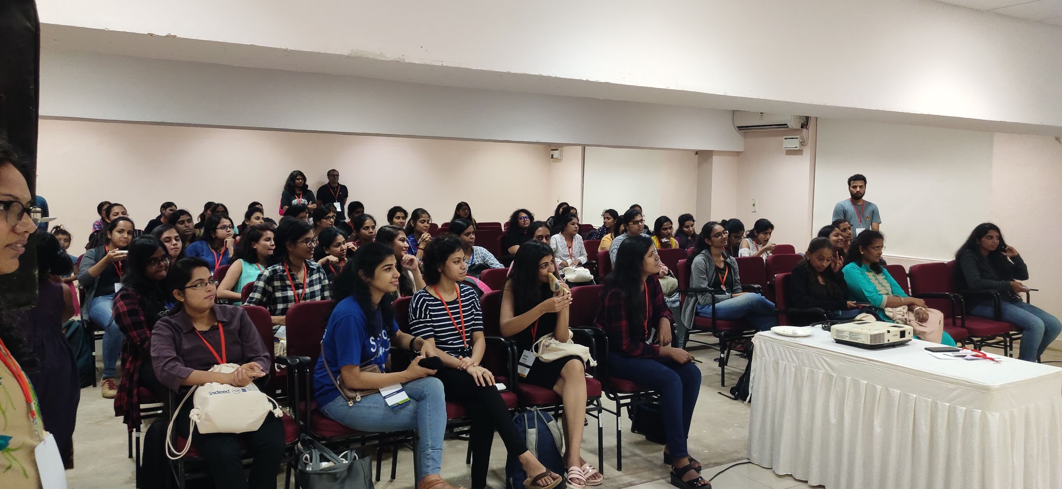
PyLadies @ PyCon India 2019
PyLadies Lunch
PyLadies Speed Mentoring

Slide 9
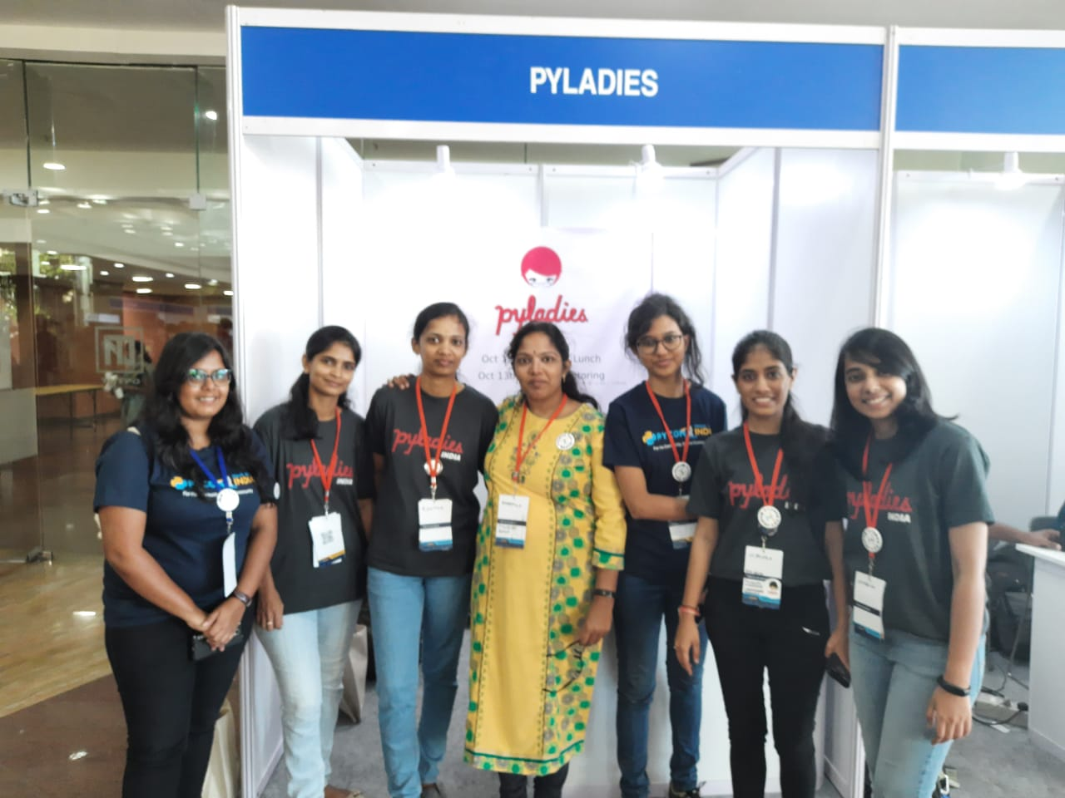
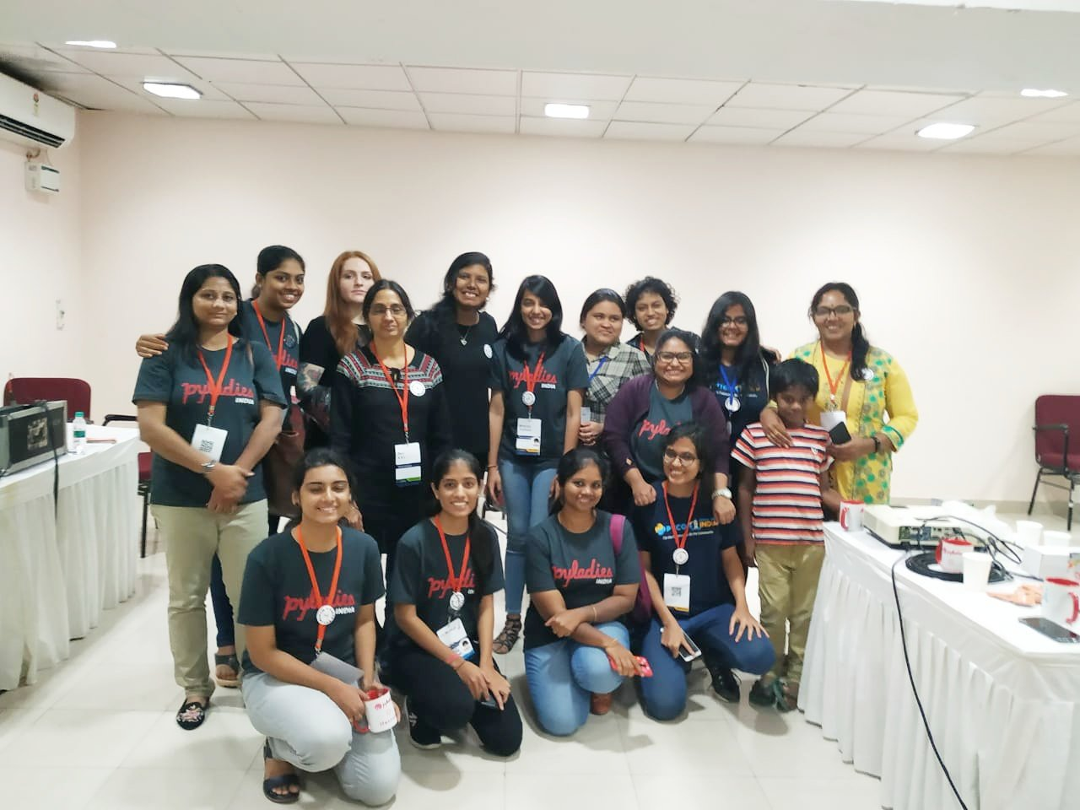
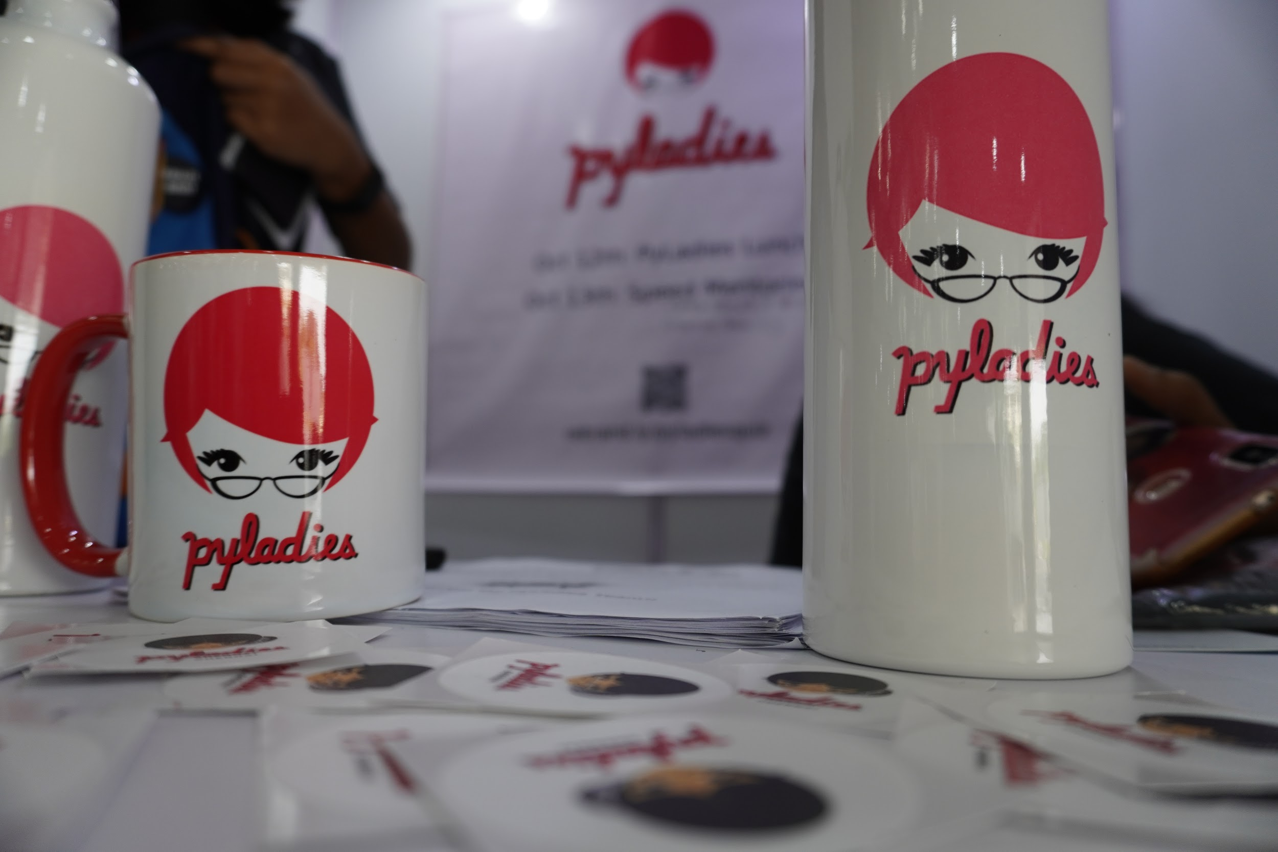
PyLadies India team and PyCon Diversity Team
With 2 Keynote Speakers
Ines Montani (Founder of Explosion.AI - SpaCy)
ASL Devi, pioneer of PyLadies in India

Slide 10
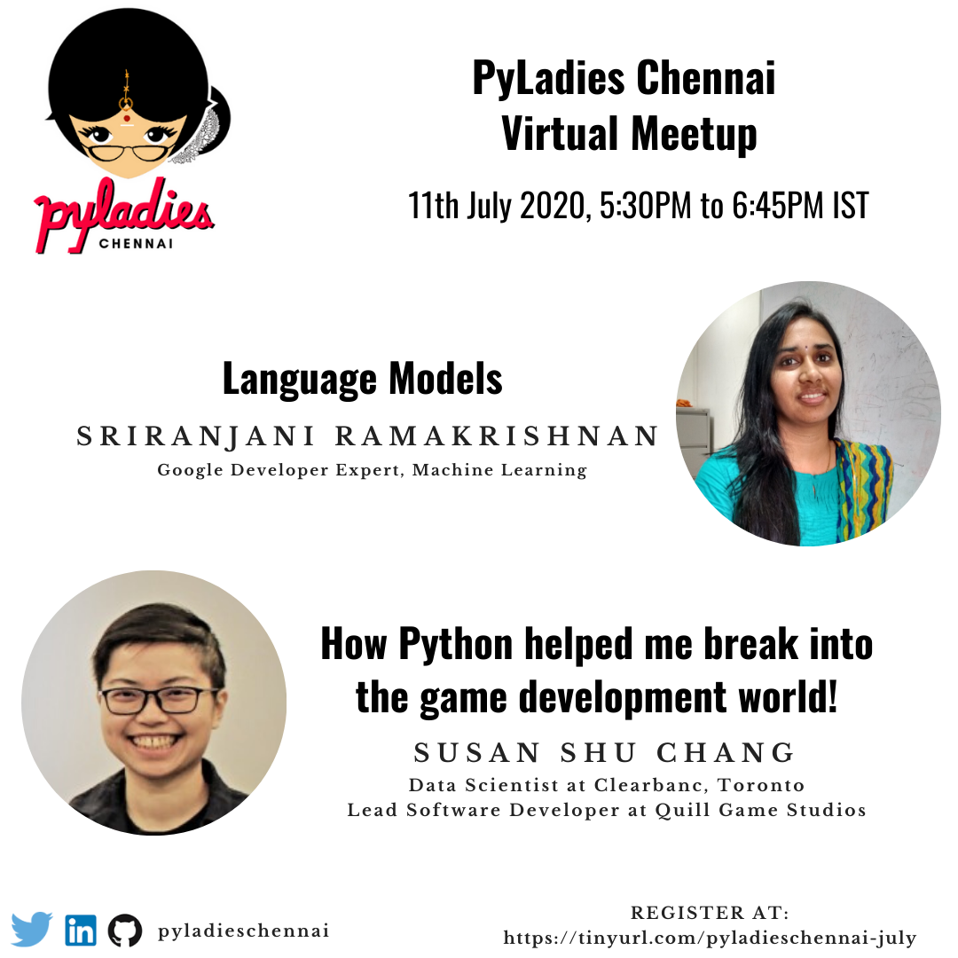

Slide 11


Slide 12
Things to Remember 📝
Submit a Talk / Workshop: bit.ly/cfp-pyconindia
Join here for discussion / Volunteer: bit.ly/join-pyconindia
Website: in.pycon.org
Twitter: @pyconindia

Slide 14
Want to get involved?
Global Slack Channel: slackin.pyladies.com
Do join the channel “city-chennai” for PyLadies Chennai discussions
Want to speak at our future meetups: tinyurl.com/pyladieschennai-speaker
Join our Whatsapp group: https://tinyurl.com/pyladieschennai-whatsapp
Most active on twitter: https://twitter.com/pyladieschennai
LinkedIn: https://www.linkedin.com/company/pyladieschennai/
To get notified of future events: https://www.meetup.com/pyladieschennai
For speaker slides and resources, https://github.com/pyladieschennai

